Slide 1
Cloud Security
Anjuru Lokesh (18BCS006)
Ch N V Avinash(18BCS021)
Diddi Geetha Krishna (18BCS025)
Submitted to:
Dr.Malay Kumar

Slide 2
Introduction
Nowadays , everything everywhere is changing to the cloud. So while it comes to the Medical department , when we use cloud for medical as present technology has many flaws there is a privacy risk.
Means the reports that is Electronic Health Records (EHRs) were stored in cloud and it was authorised by a user that is patient and it was given access to the doctor by the permission of the user.
Meanwhile, authorized doctors can perform queries on EHRs provided by hundreds of thousands of patients, and later collect qualified biomedical data to build a diagnosis model.

Slide 3
Privacy preserving Range query schemes in cloud-based eHealth Systems:
Privacy preservation.
Functionality and efficiency.
Order-preserving encryption (OPE) enables efficient range query on encrypted data, which balances the efficiency and security. OPE schemes have been proposed for a single data-source scenario, which involves a data provider and a cloud server. Multi-source order-preserving encryption schemes have been used in cloud-based eHealth systems.

Slide 4
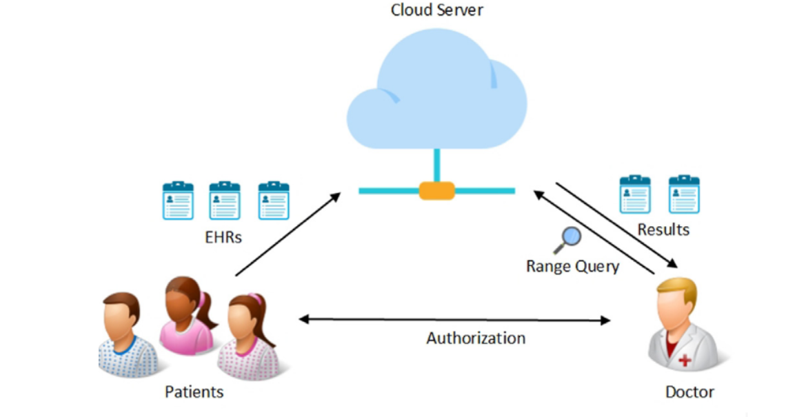

Slide 5
Attacks:
Honest but curious model is adopted in privacy-preserving in cloud computing.The HbC adversary will follow the protocol honestly but be curious about the data content.
Patient:: We assume that each patient in our scheme is HbC adversary, who is only authorized to access his/her EHRs but curious about the content of other patients’ EHRs.
Cloud Server: Meanwhile, the cloud server is considered as a HbC adversary, who is curious about the content of patients’ EHRs and the doctor’s query.
Doctor: The doctor is considered as an honest user because he/she is authorized to perform range queries to the patients’ EHRs.

Slide 6
Privacy leakage: Privacy leakage means that a cloud server may recover the encrypted EHRs to the plaintext form if the encrypted EHRs leak additional information other than the order Information.
Frequency analysis: Frequency analysis means that a cloud server may analyze the distribution of encrypted EHRs and further recover the encrypted EHRs to the plaintext form because some order-preserving encryption schemes reveal the distribution information of EHRs and the content of EHRs are not distributed uniformly. The encrypted field ‘‘gender’’ of EHRs may be recovered by the cloud server because the encrypted EHRs reveals the distribution of ‘‘gender’’ and the cloud server learns that the keyword ‘‘female’’ appears more frequently than ‘‘male’’ in a gynaecology hospital

Slide 7
Identical data inference: Identical data inference means that unauthorized patients may try to recover the content of EHRs by searching the identical encrypted EHRs. Assume that both Alice and Bob are 38 years old, and the OPE encryption of ‘‘38’’ is ‘‘357’’. Thus, the encrypted ‘‘age’’ field of both Alice and Bob are ‘‘357’’.
The MSOPE scheme(Multi Source Order Preserving Scheme)
The MOPSE scheme is designed for privacy-preserving range query on encrypted outsourced EHRs. The work-flow of privacy-preserving range query involves two phases,

Slide 8
EHRs Outsourcing:
In this step each patient invokes the encryption algorithm to encrypt his/her EHRs and later uploads the encrypted EHRs to cloud.
EhRs querying:
In this phase ,there are two different data users.
On one hand doctor performs range query over the encrypted EHrs to get required EHRs and runs decryption algorithm over them.
On the other hand patient can also invokes the decryption algorithm to decrypt the outsourced encrypted EHRs.

Slide 9
The MSOPE Construction
The MSOPE system is based on a multi-source randomised order that randomly permutes the order of identical data from various patients. We create multi-source randomised order by covertly building T and then generating order-preserving ciphertexts for EHRs gathered from different patients based on T. Secret State Generation, Encryption, Decryption, and Range Query are all polynomial-time algorithms in the MSOPE scheme.
Algorithms used in this Scheme:
Secure comparing protocol.
Secret state generation.
Encryption.
Tree node construction.

Slide 10
Secret State Update.
Cipher Text Generation.
Decryption.

Slide 11
Non Efficient way
Efficient way
Allowing all data owners and providers to upload encrypted PHRs to the cloud. which does not possess the decryption keys.
Since PHRs can be in huge volume, it is very inefficient for data owners or providers to retrieve all the encrypted PHRs from the cloud when only a small portion of them are needed.
So Here as it is Manual way there may be no privacy concerns but as it is huge data it is inefficient
To enable efficient queries over encrypted PHRs, the B + -tree technique, which is proposed to build an index for each patient’s PHRs.
The data index allows the cloud server to quickly find all the PHRs matching a particular data query.
To further resolve the privacy concerns about data indexes and queries, searchable encryption schemes are proposed to encrypt data indexes and queries as well

Slide 12
About MOPSE
Multi-Source Order-Preserving Encryption
MOPSE supports multi-patient situations and order-preserving encryption techniques that are multi-source (sometimes abbreviated as multi-provider or multi-user). MOPSE schemes not only protect the privacy of EHR contents but also enable efficient range queries over multi-source encrypted EHRs. Most of the existing schemes focus on practicality but leak both the value of plaintext and the distance between any two plaintexts.

Slide 13
About MEIM
Multi-source Encrypted Indexes Merge
MEIM is a new method that allows a cloud server to combine several encrypted data indexes from different health providers for the same patient without compromising on the patient's privacy. It also allows the user to create a single encrypted query that searches all of his health providers' encrypted data on the cloud server. MEIM is built around a novel Multi-source Order-Preserving Symmetric Encryption (MOPSE) primitive. The order of various data indices encrypted by separate symmetric keys is preserved by MOPSE.

Slide 14
System Model
This shows the users and their roles
DATA OWNERS
Patients who save their data in the cloud are known as owners, and they grant permission to data providers or their doctors to run searches and report the results.
DATA PROVIDERS
Data Providers are hospitals that allow owners to upload their data to the cloud and manage their EHR, as well as doctors who have access with the owner's consent.
CLOUD SERVERS
These servers are the public storage location for all encrypted data, and they allow only authorised users to conduct queries, with the result being encrypted in our system as well

Slide 15
Proposed model with Advanced Security
The problem of privacy-preserving query for multi-source
The MEIM mechanism enables authenticated data owner to achieve secure, convenient, and efficient query over multiple data, providers' data. To implement the efficient query, we introduce MDBT as the data structure. To reduce the overhead of query generation of data owner, we propose a novel multiple order-preserving symmetric encryption (MOPSE) scheme. To make the model more practical, we propose an enhanced multiple order-preserving symmetric encryption (MOPSE + ) scheme to satisfy the hierarchical authenticated query.

Slide 16
MOPSE+ and Algorithms

Slide 17
MOPSE+ and Algorithms
We can construct a hierarchical structure for data providers with the basic solution MOPSE, which involves issuing all keys of data providers with lower privileges to those with higher privileges. The technique, however, is inefficient, because the overhead of key management grows linearly with the number of data providers with lesser privileges, and data providers must generate a large number of queries (the number is proportional to the number of providers). We presented an upgraded system (called MOPSE + ) based on our earlier scheme to combat these inefficient difficulties. MOPSE+ and Algorithms.
Our system uses a novel Multi-source Encrypted Index Merging (MEIM) technique, which allows the cloud server to combine encrypted data indexes from different data providers for the same data owner without having to decrypt the data. Indices that are unique to each person. MEIM allows a data user to submit a single data query for all of the data owner's PHRs from all of the data providers. In what follows, we introduce the basics of indexing and querying PHRs, followed by the MEIM design.

Slide 18
Algorithm is divided into
INDEXING AND QUERYING PHRs
OVERVIEW OF MEIM
CONTINUOUS INVESTMENT IN CYBERSECURITY AND SECURITY TECHNOLOGY.
MULTI-SOURCE ORDER-PRESERVING SYMMETRIC ENCRYPTION
GENERATING ENCRYPTED INDEX

Slide 19
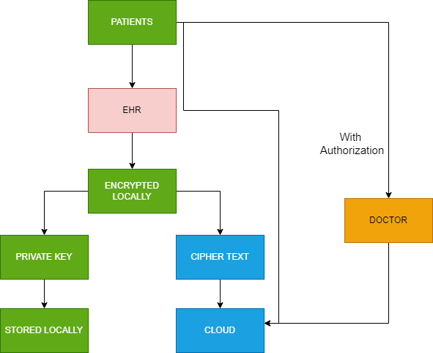
Implementation:

Slide 20
Conclusion
In this work, I identify three vulnerabilities in cloud-based eHealth systems: privacy leakage, frequency analysis, and identical data inference. I’ve also established the indistinguishability under multi-source ordered chosen plaintext attack IND-MSOCPA security concept for multi-source order-preserving encryption to capture the security characteristics that protect against attacks. I also proposed the MSOPE technique, which enables doctors in cloud-based eHealth systems to perform privacy-preserving range searches across outsourced EHRs from a large number of patients. We can conclude that this scheme is secure from the above mentioned attacks. Extensive performance testing has shown that the MSOPE method is more efficient than the original version.

Slide 21
Thank you

